Slide 1

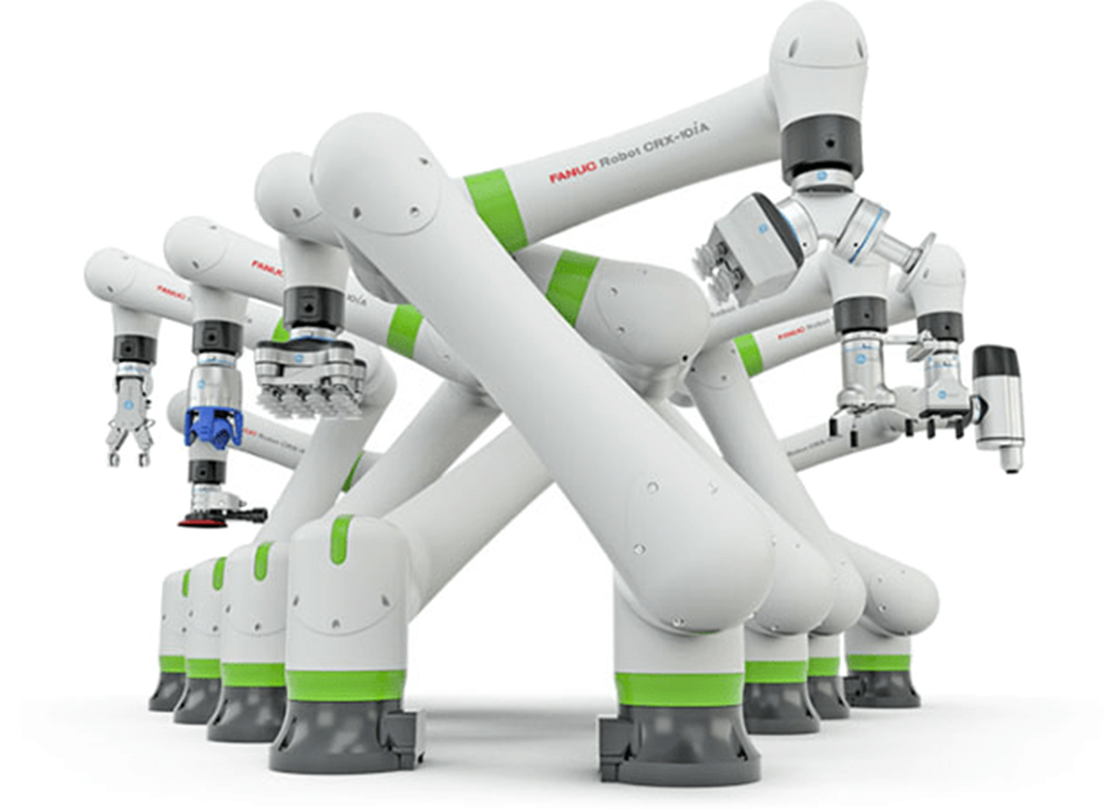
SMART TECHNOLOGY
MINI CNC PLOTTER

Slide 2
CNC PLOTTER DEFINATION

Slide 3

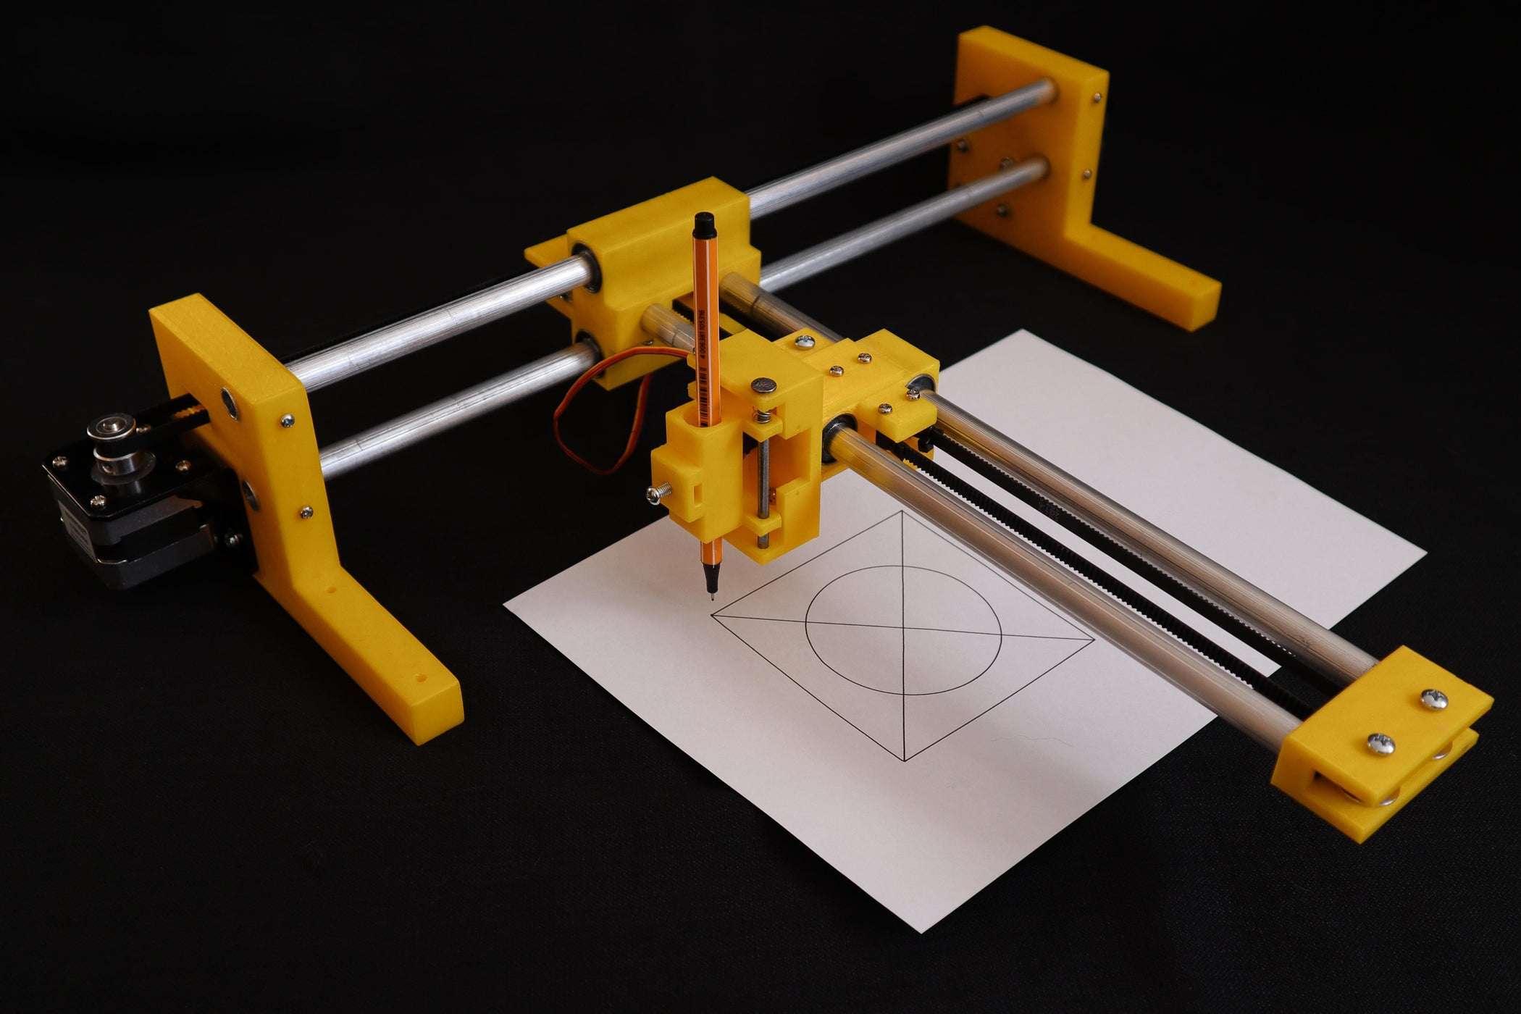
What’s CNC Plotter Idea?
A MINI CNC Plotter is like a tiny robot artist that can draw pictures for you. It has a small computer brain that you can give instructions to using a computer. The plotter has moving parts that help a pen draw on paper, just like you would with your hand. It can draw lines, shapes, and even write words very neatly and accurately. For example, if you want it to draw a house, you tell it to draw a square and a triangle, and it does it perfectly without any mistakes. It's a fun way to create cool drawings and learn about how robots work!

Slide 4
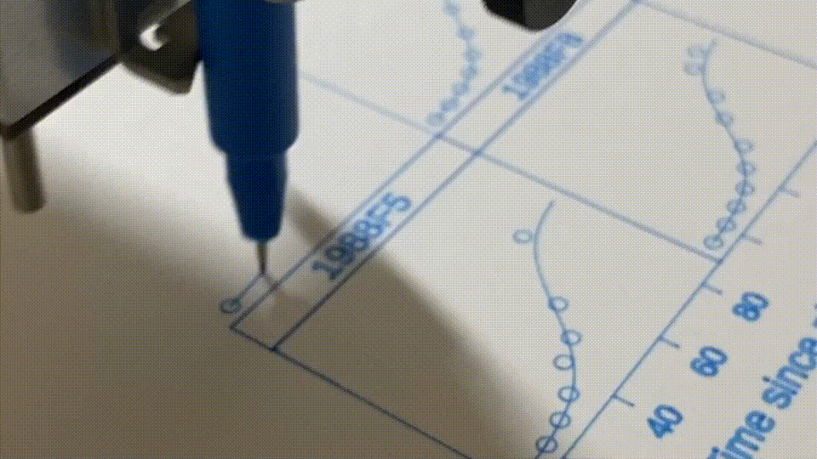
What’s CNC Plotter Idea?

Slide 5
3D PARTS
CNC

Slide 6
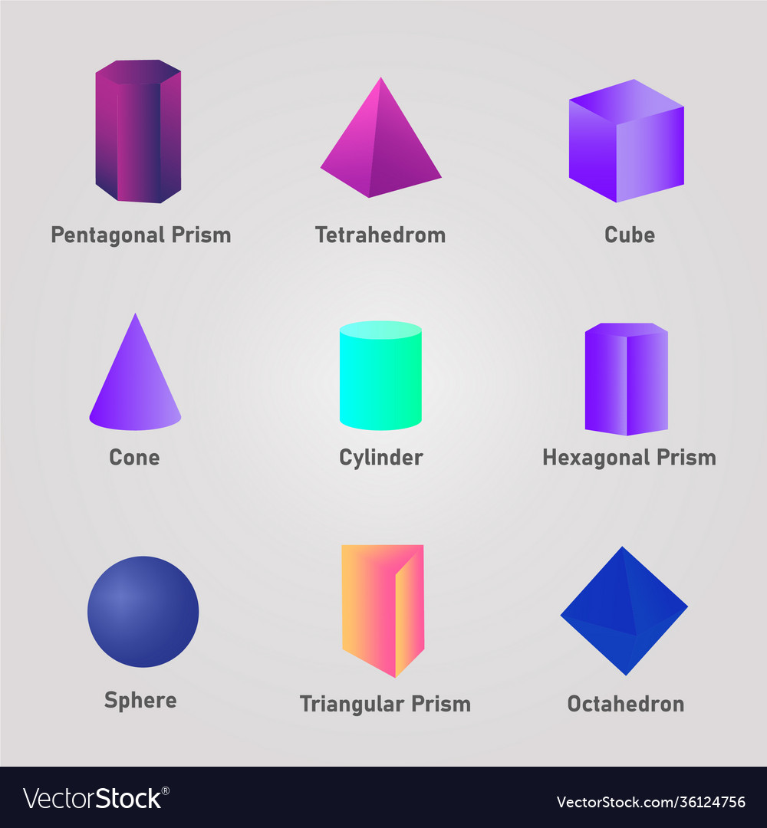
What’s “3D” in real-life ?
In real life, "3D" stands for three-dimensional. It means something has height, width, and depth, just like the objects you see and touch every day. For example, a ball is 3D because it's round and you can hold it in your hands. A book is also 3D because it has pages that you can flip through, and it takes up space on a shelf. Unlike a flat picture or drawing, which is two-dimensional (2D) and only has height and width, 3D objects have an extra dimension that makes them solid and real. This is why movies or games that are in 3D look more lifelike, because they have that extra depth that makes things pop out and feel more real. So, 3D in real life refers to the way things have volume and take up space in all directions.

Slide 7
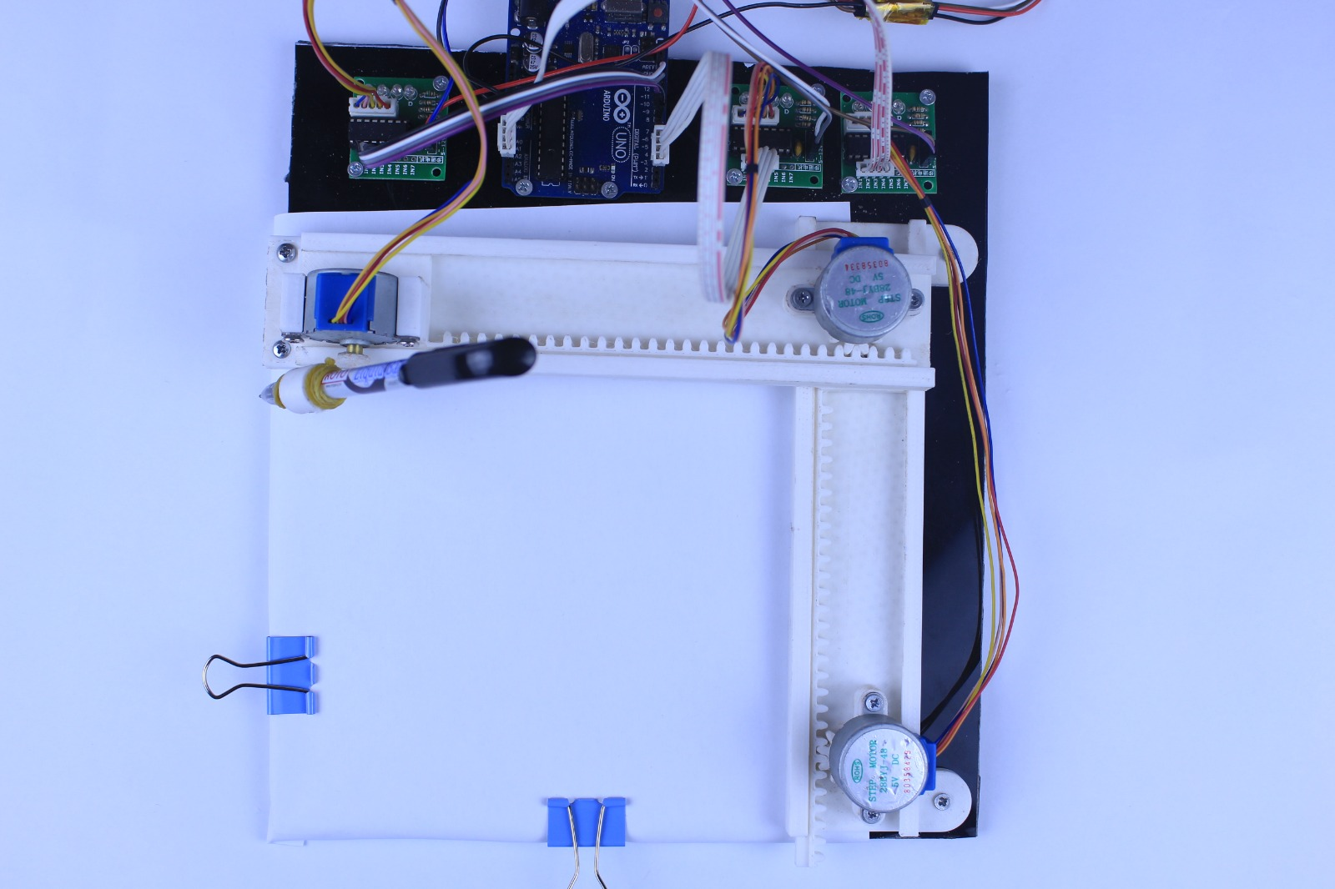
3D parts of our CNC Mini Plotter
For the following image:
we will demonstrate the following mini cnc plotter in real life!
And for 3D parts will talk about it in next slides
But for now, this image of the Design will work on

Slide 8

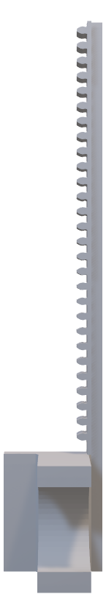
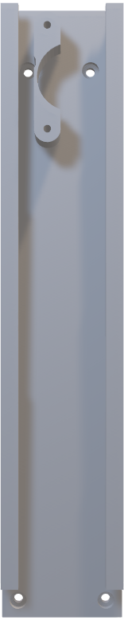
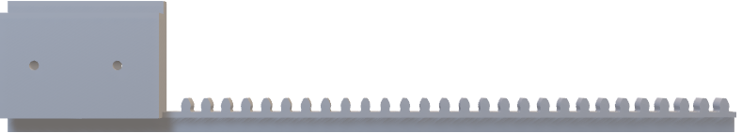
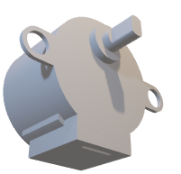
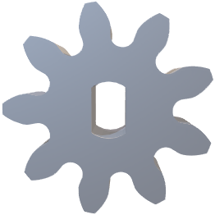
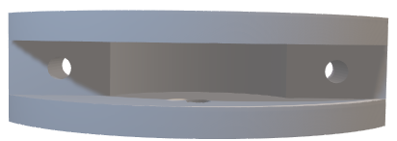
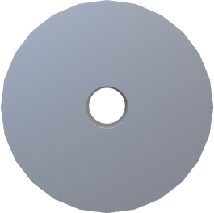
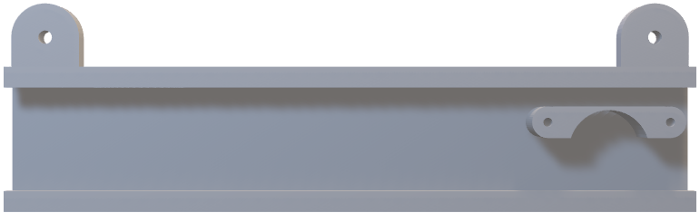
3D Parts in our CNC Plotter

Slide 9
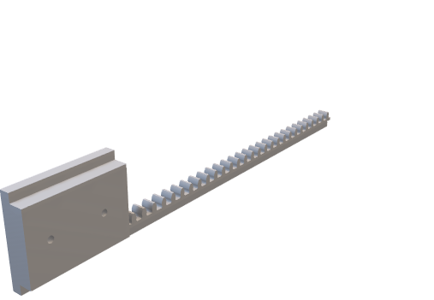
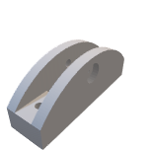
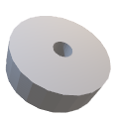

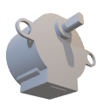
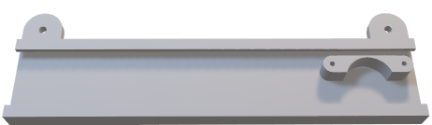
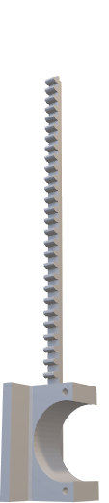
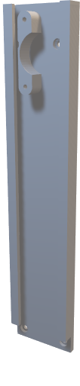
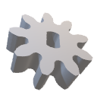
3D Parts in our CNC Plotter
For this part will store the stepper Y, which will move the stepper Z that handles the pen, treat it like “X” Axis of design
This part will handle the process of moving the pen up and down, treat this also as “Y” Axis of the design
This part will handle the connection between the part of “X” and “Y”, which will make the both connected well
This part will handle the process of pen holder, will set up stepper Z and will connect it

Slide 10
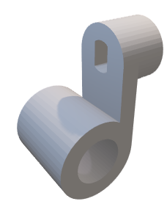
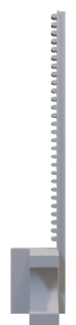


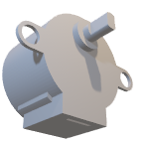
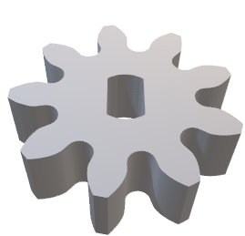
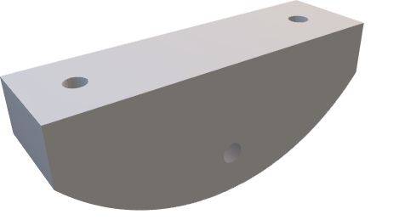
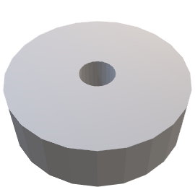
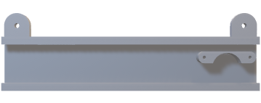
3D Parts in our CNC Plotter
This Wheel will get treated
Like simple bicycle which will move
The connection between X and Y
This Gear will handle
The moves of stepper for the 3 parts, the x stepper, the y stepper and z stepper
This Holder will
Keep the pen safe for writing without any trouble, and will relate to Z Stepper
This Component will relate to the wheel to treat it totally like simple bicycle, this will save the power of stepper and sill move the pen smoothly.

Slide 11

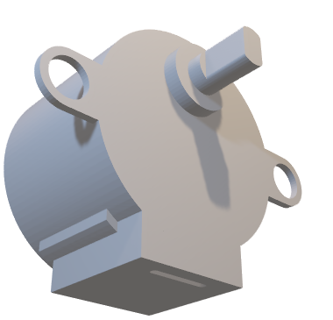
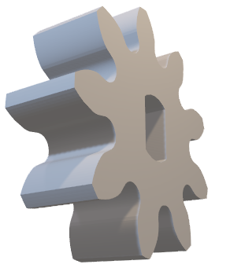

Let’s Connect Together!
1
First thing attach the both gears on stepper X and Stepper Y

Slide 12
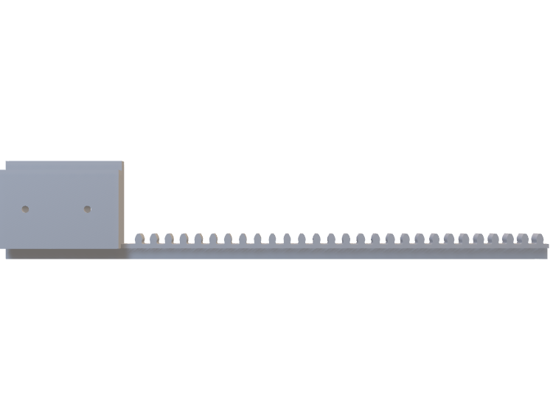


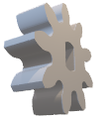
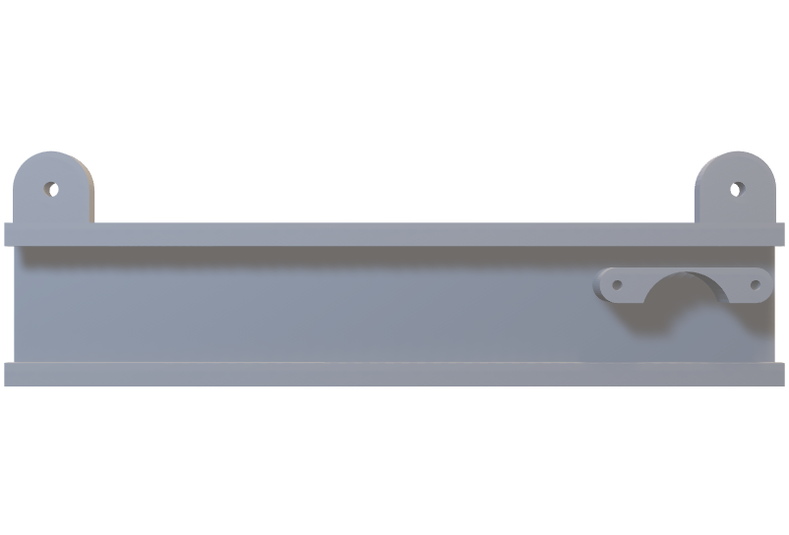
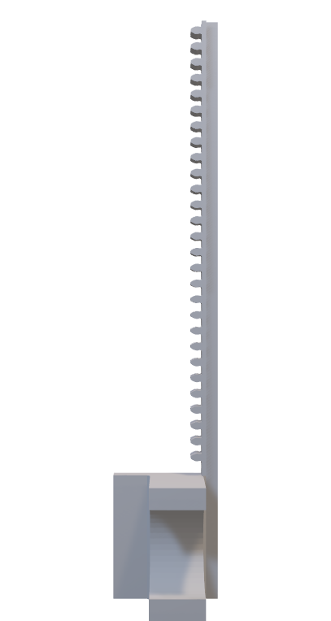
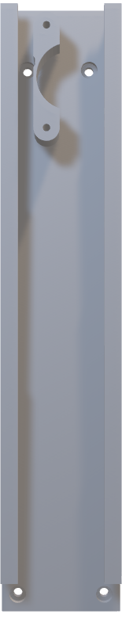

Let’s Connect Together!
2
Second thing attach Connect the movers in the holders to make it ready for moving in x axis and y axis perfectly.

Slide 13
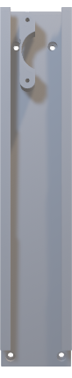
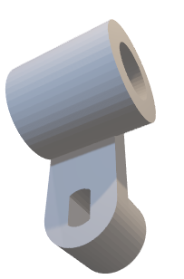
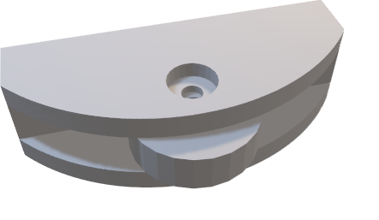
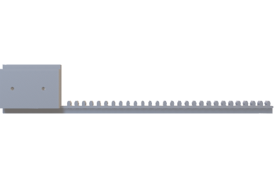
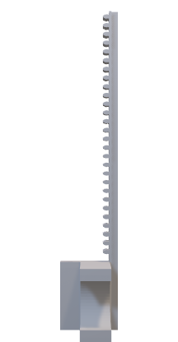
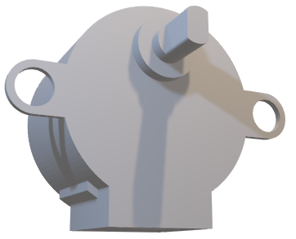
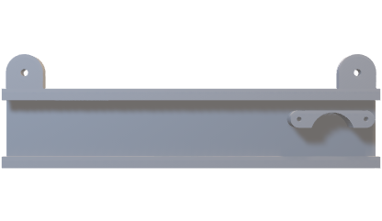
Let’s Connect Together!
3
Connect the rest of steppers and attach cycle with its holder to make it like simple bicycle and will connect it with x axis holder
And connect the pen holder with stepper Z

Slide 14
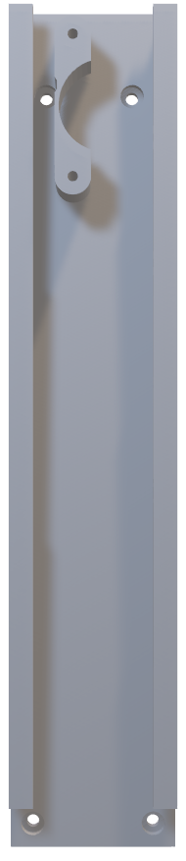

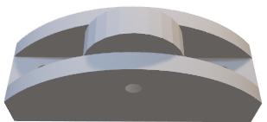

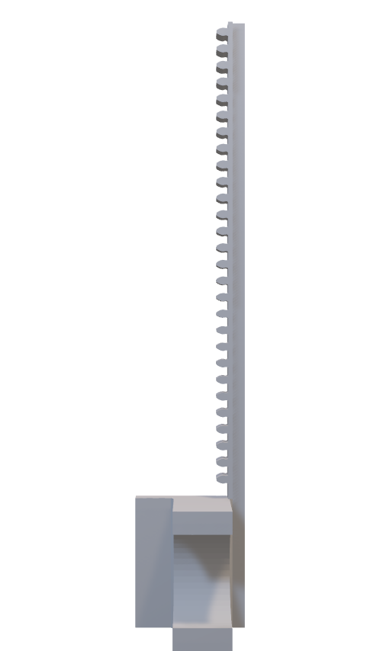
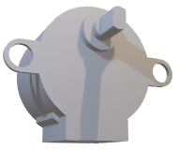
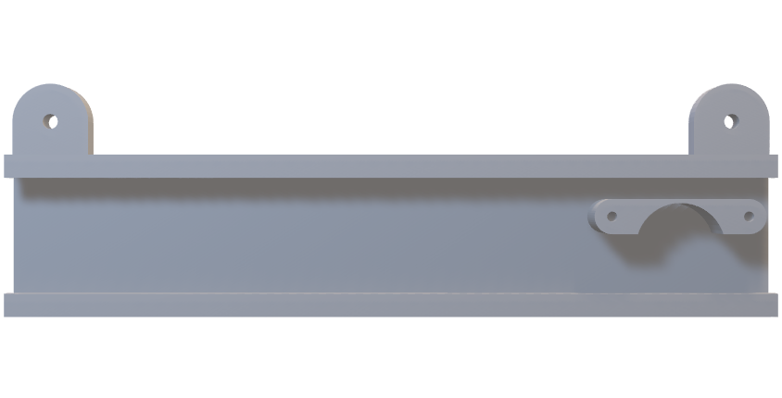
Let’s Connect Together!
4
Now will connect the two parts by of x and y by setting suitable nails to make it perfect

Slide 15
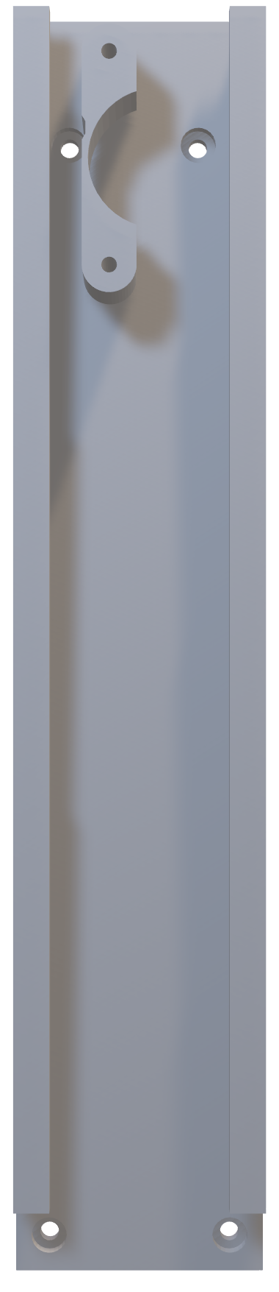
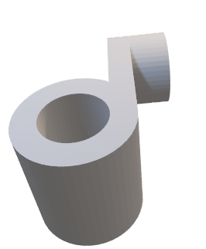
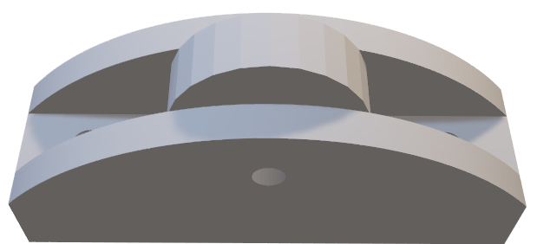






Let’s Connect Together!
x
Y
5
After Connecting the 2 parts of x and y, set all the steppers in it’s position, and you will find each stepper located with its symbol.

Slide 16



Let’s Connect Together!
Last thing we have is to connect the wheel with X axis part, and we can say that you have your own CNC plotter now!
7

Slide 17

Let’s Connect Together!
8

Slide 18
Inkscape

Slide 19

Inkscape Designing
Inkscape is a free design program that helps you create and edit images, especially vector graphics (which are made of lines and shapes that stay sharp when resized). It also works with regular images (called bitmaps).
Inkscape is similar to Adobe Illustrator, but unlike Illustrator, which requires a paid subscription, Inkscape is completely free. If you mainly work with regular images instead of vector graphics, other free programs you might want to try are GIMP, Krita, or Sketchbook.

Slide 20

Let’s Connect Together!
1

Slide 21

Inkscape Designing
2

Slide 22

Inkscape Designing
3

Slide 23

Inkscape Designing
4

Slide 24

Inkscape Designing
5

Slide 25

Inkscape Designing
6

Slide 26

Inkscape Designing
7

Slide 27

Inkscape Designing
8

Slide 28

Inkscape Designing
8

Slide 29

Inkscape Designing
9
10

Slide 30

Inkscape Designing
11

Slide 31

Inkscape Designing
12

Slide 32
Inkscape Designing
13

Slide 33

Inkscape Designing
14
Now your image is ready to set up for our plotter.

Slide 34
JScut

Slide 35

JS-cut for SVG to CNC
1

Slide 36

JS-cut for SVG to CNC
2

Slide 37

JS-cut for SVG to CNC
3
4

Slide 38

JS-cut for SVG to CNC
5

Slide 39

JS-cut for SVG to CNC
6

Slide 40

JS-cut for SVG to CNC
7

Slide 41

JS-cut for SVG to CNC
8

Slide 42

JS-cut for SVG to CNC
10
11

Slide 43

JS-cut for SVG to CNC
13
12

Slide 44

JS-cut for SVG to CNC
14

Slide 45

JS-cut for SVG to CNC
15

Slide 46
UGS

Slide 47

UGS
1

Slide 48

UGS
2

Slide 49

UGS
3

Slide 50

UGS
4

Slide 51

UGS
5

Slide 52

UGS
6

Slide 53
UGS
6

Slide 54

UGS
7
8

Slide 55

UGS
9
10

Slide 56

UGS
11

Slide 57

UGS
12

Slide 58

UGS
13
14

Slide 59



UGS
Fast Note
Ensure that distance between X, Y and Z steppers to near for this style

Slide 60

UGS
14

Slide 61

UGS
15

Slide 62

UGS
16

Slide 63

UGS
17

Slide 64

UGS
18

Slide 65

UGS
19

Slide 66
Notes

Slide 67
Some Notes
If the image has too many details, it may not produce good results with this simple CNC.
Ensure that your X, Y, and Z stepper motor configurations are 100% accurate for optimal performance.
Keep the Arduino always connected to UGS.
When you press "Reset to Zero," the pen should lift and then lower down.
Correct driver connections are crucial; refer to the connection diagram to verify that all pins and components are properly connected.
It’s so simple CNC plotter, so if image has a lot of details, it will take long time, if it has a small details, approximately will take between 5 – 10 mins based on how this image details.
That’s all for now, Try your own one!

Slide 68
DONE!!

